Slide 1


Performance Characterization & Call Reliability Diagnosis Support for Voice over LTE
Yunhan Jack Jia, Qi Alfred Chen, Z. Morley Mao, Jie Hui†, Kranthi Sontinei†, Alex Yoon†, Samson Kwong†, Kevin Lau†
University of Michigan, T-Mobile US Inc.†¹
¹ The views presented in this paper are as individuals and do not necessarily reflect any position of T-Mobile.

Slide 2
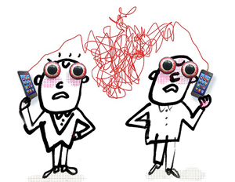
Your voice call needs an upgrade
Data network evolution:
2G -> 3G -> 4G/LTE
Carrier’s voice call:
All circuit-switched before 2014
Moving to a data-centric world
Voice over LTE
Illustration: Serge Bloch

Slide 3







Voice over LTE
Deliver voice service as data flows within LTE network
VoLTE
Internet
Packet-Switched Core
ENodeB
Circuit-Switched Core
Telephony
Network
Legacy call
NodeB
For operators: reduce cost.
Performance benefit for users is unclear
1

Slide 4






Challenge 1: Guarantee VoLTE performance
Guaranteeing QoS is challenging
High user expectation on VoLTE
Goal: Replacing legacy call
Default Bearer
Internet
User
Dedicated Bearer
Gateway
Bit rat: 50 kbps,
Delay: 100 ms,
2

Slide 5




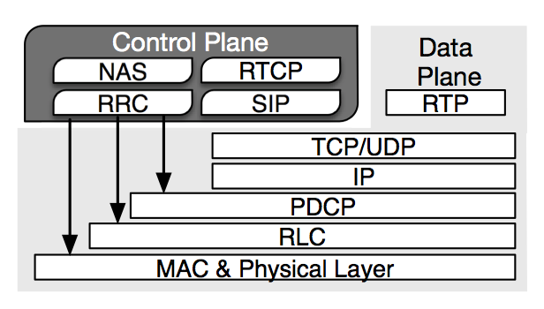


Challenge 2: Diagnose VoLTE problems
VoLTE is a complex service
C\\\\\\\\\\\\
LTE Coverage Constraints
3G/2G Network
C\\\\\\\\\\\\
Cross-layer Interaction
C\\\\\\\\\\\\
Device-network Interactions
Multiple Layers
Multiple Layers
LTE Network
C\\\\\\\\\\\\
Mobility Support
Existing approach: User tickets
subjective, less accurate, coarse-grained
3

Slide 6
Problem statement
* Definition: Quality of Experience (QoE)
Quality as seen by the end-user
E.g., network call setup time vs. user perceived call setup time
Insufficient understanding of QoE of deployed VoLTE services
No effective support to capture and diagnose VoLTE problems
4

Slide 7
Contributions
Systematic study of VoLTE in commercial deployment
QoE quantification
Empirical comparisons with legacy call & OTT VoIP
Diagnosis support for VoLTE reliability problems
Devise tool to capture audio experience problems efficiently
Covers three major symptoms in user tickets
Uncover potential causes lying in the VoLTE protocols
E.g., Up-to-50-second muting caused by mis-coordination between two different standards
5

Slide 8
Outline
Performance characterization
Methodology overview
Result summary
Diagnosis support for VoLTE reliability problems
Capturing audio experience problems
Audio quality monitor
Backend diagnosis engine
Stress testing approach & diagnosis
Case studies
Discussion
7

Slide 9



Methodology overview
VoLTE service providers
OP-I | OP-II | OP-III
Comparing entities
Legacy call | Skype | Hangouts Voice
Metrics we study
Smooth audio experience
audio quality (MOS), mouth-to-ear delay and more
Energy consumption
Bandwidth requirement
Reliability
Call setup success rate
Call drop rate
8

Slide 10
Result overview
VoLTE delivers excellent audio quality with
low bandwidth requirement
less user-perceived call setup time
low energy consumption
won’t be affected by background traffic
Reliability still lags behind legacy call
Higher call drop rate (5X)
Higher call setup failure rate (8X)
9

Slide 11



Call reliability support of VoLTE
Challenge: Unsatisfying and varying network conditions
VoLTE reliability support
Circuit-switched fall back
Single Radio Voice call Continuity
2G/3G Core
2G/3G
IMS
LTE Core
LTE
CSFB Procedure
SRVCC Procedure
However,
VoLTE still fails to achieve a comparable reliability with legacy call
Not all VoLTE problems are captured by traffic-analysis based approach
12

Slide 12
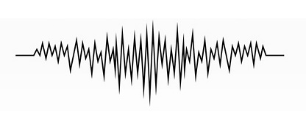

Audio quality monitor overview
Use audio channel to detect QoE problems in real-time
Three types of VoLTE reliability problems
Audio experience related problems
Muting, garbled audio, intermittent audio, one-way audio
Call setup failure
Unintended call drop
Voice Call
Normal
Muting
Intermittent audio
Audio
Quality
Monitor
Sampler
Context Collector
15

Slide 13
Audio quality monitor evaluation
Implementation based on Android AudioRecord API
Accuracy: FP: 0.65%, FN: 3.7%.
Energy Overhead: +7% during VoLTE call
Complementary to traffic-based anomaly detection
Closer to user experience, easier to deploy.
Useful diagnostic tool for operators
Capture end-user audio problems objectively and accurately.
More important: Understand the underlying causes of the problems
15

Slide 14



Stress testing approach & diagnosis
Motivation
Producing more problematic cases
Gathering critical logs in lab settings
Multi-Layer Logs
Cross-layer
Diagnosis
Potential
Causes
Audio Quality Monitor
Anomaly Detection
Device
Logging
Automation
Network Logs
Signal Strength
Network Events
Lab settings
20

Slide 15
Diagnose long audio muting problem
Problem capturing
Up-to-50-second audio muting [Audio quality monitor]
Triggered by signal strength degradation [Context collector]
Problem diagnosing
Gap between radio link layer timeout and RTP layer timeout
Application
Control VoLTE call session
RTP
Transmit voice packet stream
RRC
Control the radio link connection
RLC
Transmit low level protocol data unit

Slide 16
Lacking of coordination in cross-layer interactions
RTP Timeout :
Recommended minimum value =
360/bandwidth(kbps)
30 to 50 seconds!
Muting Start
Muting End
Application
RTP
RTP Timeout
Reestablishment
Timeout
Go to RRC_IDLE
RRC
…
Radio Link Failure
RLC
Less than 5 seconds
Radio Link Disconnection
MaxRetx
Threshold
=
+
min{T₃₀₁, T₃₁₁}
Radio Layer Timeout
RTT * maxRetxThreshold
25

Slide 17
Lacking of coordination in cross-layer interactions
RTP layer makes wrong assumption on the radio layer failure recovery
Cause: Gap between RTP (defined in RFC) and RRC/RLC (defined in 3GPP) protocol
Also causing similar problems in Skype and Hangouts
Suggested solutions
Reporting radio link events directly to application layer
Other case studies detailed in the paper
26

Slide 18
Discussion
Limitation of diagnosis support
Coverage
Not fully automated
Follow-Up
Integrating OEM support for QoE problem diagnosis
Adding diagnosis support into protocols
27

Slide 19
Summary
First systematic study of VoLTE QoE in the commercial deployment
Provide diagnosis support for VoLTE
Audio quality monitor to capture problems
Stress testing approach to collect essential information
Cross-layer diagnosis support to understand problems
29

Slide 20
Thank you!
Questions?

